Slide 1
Tableau Project Report
Arti agrahari

Slide 2
Problem Statement
The tweets are collected using Twitter API and a Python script. A query for this high-frequency hashtag (#covid19) is run on a daily basis for a certain time period, to collect a larger number of tweets samples. The tweets have #covid19 hashtag. Collection started on 25/7/2020, with an initial 17k batch and will continue on a daily basis. Use this data to dive into the subjects that use this hashtag, look to the geographical distribution, evaluate sentiments, looks to trends.
Source of Data: Kaggle

Slide 3
Summary
The dataset has 1,79,106 rows and 13 columns
Each row represents a tweet with hashtag #covid19 during the coronavirus pandemic 2020
The dataset has users, location information along with the followers and tweets
Analyze the user and geographical distribution of dataset
Look for subjects, trends and sentiments during the pandemic
Project & Video link

Slide 4
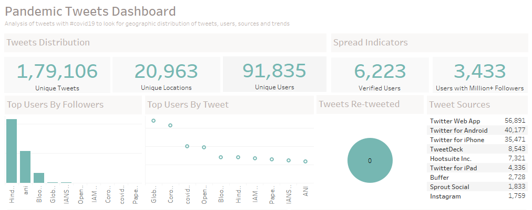
Distribution Analysis

Slide 5
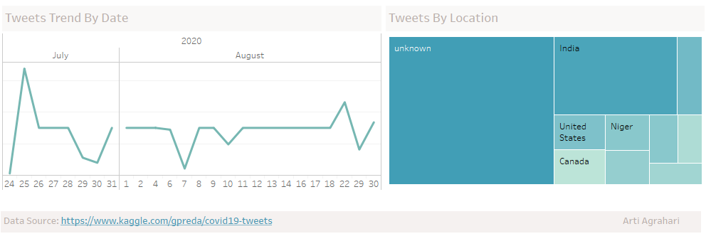
Geography & Trend Analysis

Slide 6
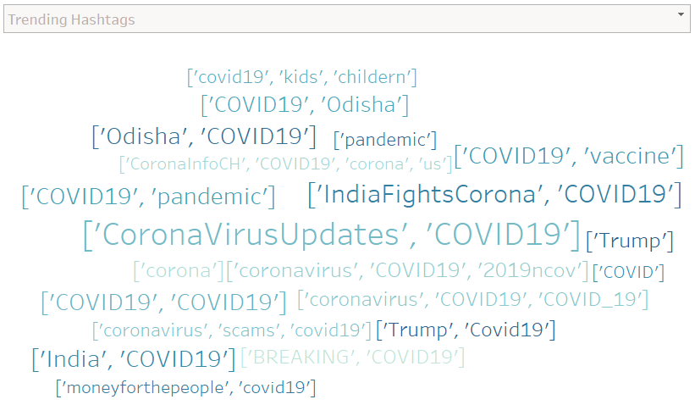
Trending Hashtags

Slide 7
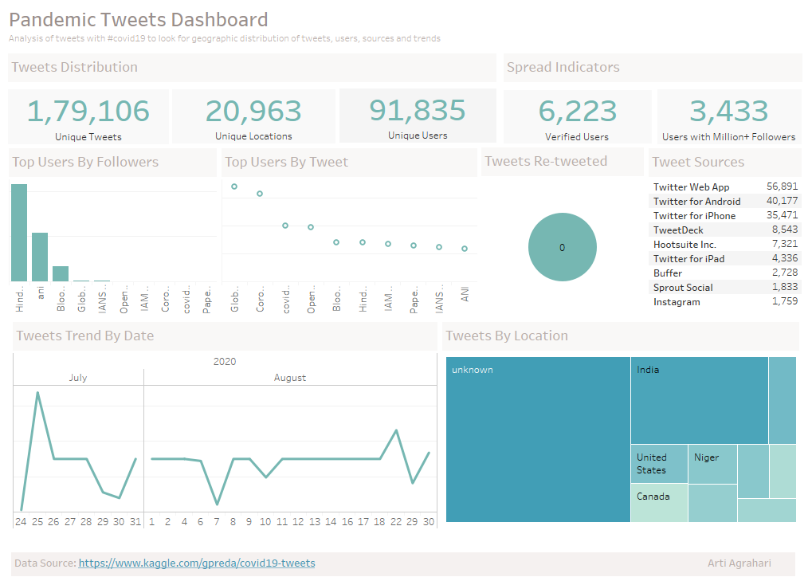

Slide 8
Conclusion
How many post are made with Covid19?
- 1,79,106
How many unique users have posted?
- 91,835
How many unique locations were posted from?
- 20,961
How many users have more than 1 million followers(higher chances of spread)?
- 3,433
How many users are verified(denoting a known person)?
- 6,223
How many tweets are re-tweeted?
- 0
What are top 2 locations were posted from?
– India, US
Next Step : Sentiment Analysis

Slide 9
Thank You

